Slide 1

SELF INTRODUCTION PROFILE

Slide 2
PROFILE
Name: RamanaBabu Boda
Designation: Senior Sales Officer(SSO)
Territory : Visakhapatnam
District Coverage: Visakhapatnam,Vizianagaram
Experience :9 Years
Date Of Joining :10-02-2011

Slide 3
Stockiest
SUPER STOCKISTS 01
Direct Stockist 03 No. Of ISR’s 04 No. Of PSR’s 01 No. Of Sub Stockiest 41 Towns

Slide 4
Achievements & Awards
Proud to be an part of $1 billion 5000 crore winner 2012
Best sales officer south 2013-2014
Vision - 4 Engage Of Inspire 2014.
Dabur Amla Hair Oil Kajal meet-up south winner April 27 2014
Applause Trail Blazer South winner 2015-2016.
Glucose Best Sales Officer Award in AP 2018-2019.

Slide 5
Activities Worked On:
Dabur Glucose event conducted stalls and sales with free Glucose water at Anakapalli Grama Devatha festival April 2016
Dabur Glucose event conducted stalls and sales at Bheemunipatnam Grama Devatha festival February 2017
Dabur Anmol van sales activity conducted on September-2018
Dabur Real KOOLERZ mango drink stall activity conducted at Vizianagaram Grama Devatha Festival in October 2019.

Slide 6
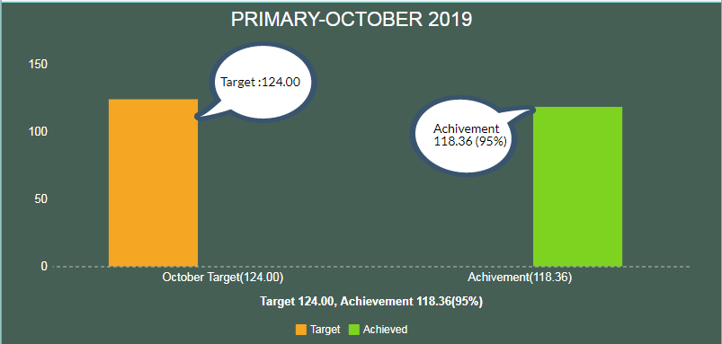
SALES PERFORMANCE OF OCTOBER -2019
Primary:

Slide 7
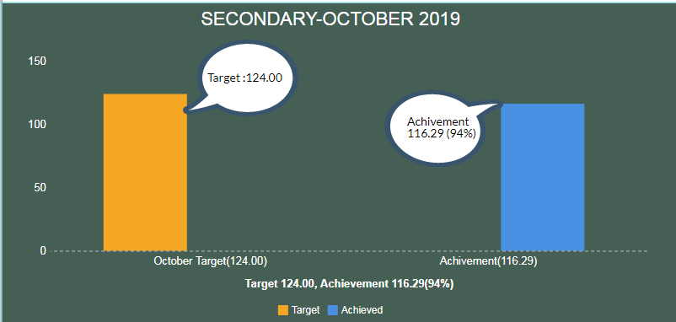
Secondary:

Slide 8
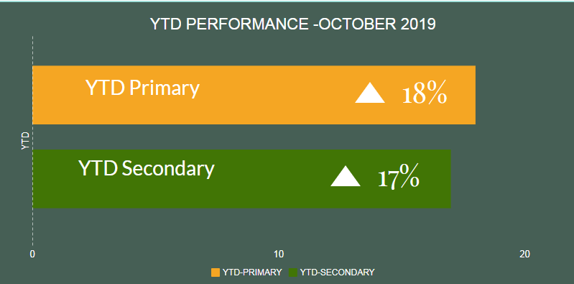
YTD Performance:

Slide 9
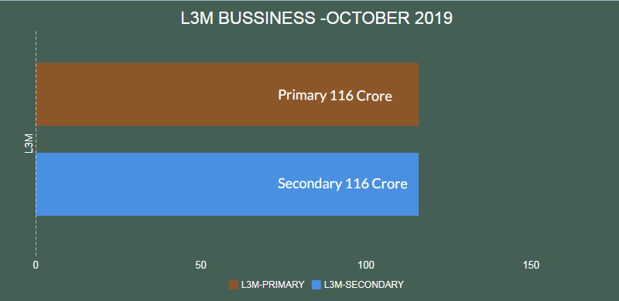
L3M BUSSINESS

Slide 10
ANIL ENTERPRISES TOP 10 PERFORMANCE’S
TOWN | VALUE AVG. P.M | OUTLETS | YTD GROWTH %
BHEEMUNIPATNAM | 5.22 | 45 | 24%
NARSIPATNAM | 9.00 | 78 | 13%
CHODAVARAM | 7.12 | 35 | -5%
KOTHAVALASA | 5.41 | 67 | 25%
S.KOTA | 7.35 | 85 | 11%
YELLAMANCHILLI | 7.20 | 44 | 7%
BOBBILI | 4.56 | 77 | 27%
SALUR | 3.86 | 56 | 27%
PARVATHIPURAM | 6.85 | 58 | 9%

Slide 11
ISR YTD PERFORMANCE
ISR NAME | HEAD QUATOR TOWN | NO.OF SUB STOCKISTS | YTD Performance
T.BALA GOPAL | VISAKHAPTANAM | 9 | 23%
M.VENKATA RAMA RAJU | VISAKHAPTANAM | 12 | 18%
R.DURGA PARMAESHWARA RAO | VIZIANAGARAM | 11 | 22%
B.SHYAM BABAU | VIZIANAGARAM | 07 | 29%
T.HARISH(PSR) | VISAKHAPTANAM | 2 | -
TOTAL |  | 41 | 23%

Slide 12
ISR PDA OUTLETS & NO.OF BEATS
ISR NAME | HEAD QUATOR TOWN | NO.OF BEATS | NO.OF OUTLETS | NO.OF SUBTOWNS | L3M BUSSINESS
T.BALA GOPAL | VISAKHAPTANAM | 16 | 464 | 10 | 33.82
M.VENKATA RAMA RAJU | VISAKHAPTANAM | 16 | 443 | 13 | 25.30
R.DURGA PARMAESHWARA RAO | VIZIANAGARAM | 14 | 387 | 11 | 26.38
B.SHYAM BABAU | VIZIANAGARAM | 12 | 297 | 7 | 11.87
TOTAL |  | 58 | 1591 | 41 | 24.34

Slide 13
THANK YOU.
https://in.linkedin.com/in/ramanababu-boda

